Slide 1

CMR COLLEGE OF ENGINEERING & TECHNOLOGY
Kandlakoya, Medchal, Hyderabad - 501401
Department of Computer Science and Engineering
Cric Alerts
A.Sai Prashanth (20H51A05A9)
B.Triyagish Prayad (20H51A05B8)
G.Hardhik (20H51A05C1)
Under esteemed guidance of
Dr.S.Kirubakaran

Slide 2
Outline
Abstract
Introduction
Literature survey
Existed system
- Problems in existed system
Research Objective of Presentation
Problem Definition
Research work
- Proposed system architecture
- Methods
- Comparison of Proposed system with an existed system
Performance Measure
Results
Conclusion
Future Work
Notes:
2

Slide 3
Abstract
Notes:
3

Slide 4
ABSTRACT
As we all know we watch cricket we admire we get thrilled and sometimes we also want to
share the cricket match scores . But for that we have to type the score manually or we have to
say our friends please watch match is wonderful their batting or bowling excellently. So why
can’t a platform be there where everyone knows the score and we can connect and share our
reactions to that.
So by taking this as a problem statement for our mini Projects we have come with a solution.
For this we have to select a platform so we have selected telegram as a as our platform this is
very simple and reliable application.

Slide 5
INTRODUCTION
Notes:
5

Slide 6
Introduction
We all like the cricket game, especially India vs Pakistan and India vs Australia matches are
very interesting and we enjoy the match. As many people want to watch the match live in
the stadium, but only some people can get the chance of watching the live, due to some
reasons like not having enough seats in the stadium, money problem, etc. So, people
will search in the websites to watch the live score, but sometimes it takes some time for
the process and etc.We took the problem and we want to solve this problem by creating
the telegram bot. This bot can show the live score of live matches and by and this telegram
bot can show the every detail of the match live.But the thing with these websites is that
you have to keep staring at the page or refreshing it to get the latest score which can be
quite unproductive if you are in the middle of important work.But in this case we don’t
have that type of problem because it automatically updates itself.
Notes:
6

Slide 7
Literature Survey
Notes:
7

Slide 8
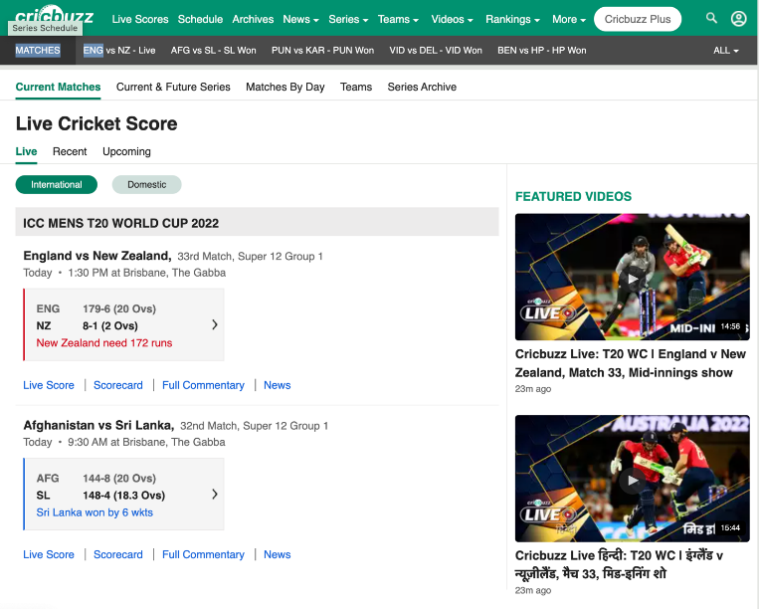
Literature survey
Existing Solutions :
Cricbuss : Cricbuzz is an Indian cricket news website owned by Times Internet. . It features, news, articles and live coverage of cricket matches including videos, text commentary, player stats and team rankings. Their website also offers a mobile application and also telegram
Notes:
8

Slide 9
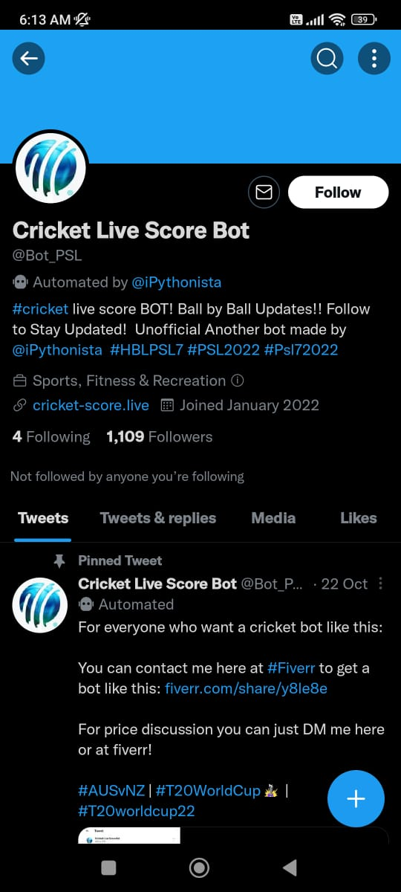
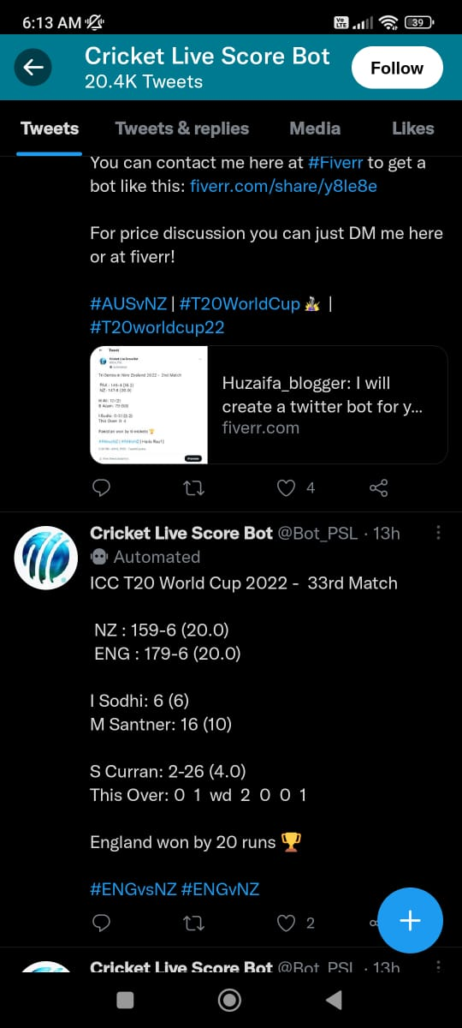
CRICKET SOCIAL MEDIA BOTS :
These Bots scrape the data by using API services and send the data to the user. The services are offered by many cricket websites and individual’s who contribute to open source.

Slide 10
Existing systems
Drawbacks in existing system :
There is more usage of the internet because of streaming the live.
If we are forget the match then it won’t give the pop message for the live match.
As in the Cricket social media bot like discord bots are community apps that connects users with the same interests.
If their will be more usage of people at a time then the server becomes slow and it may crash.
In Cricbuss sometimes the app’s first page we not be updated but the upcoming page will be updated.
In the discord app there is Broken notification System(it can’t send the notification 100% to all the account holders).
Discord are actually built for desktop platforms.

Slide 11
Research Objective
Notes:
11

Slide 12
Research objective
The project goal is to facilitate the live score of the cricket match.
This can be done by using the telegram bot.
The match score is delayed for 10 to 15 sec only.
People can also watch the live score of the match and can use othe apps.
Their will be no more heavy usage of internet.

Slide 13
Problem Definition
Notes:
13

Slide 14
Problem Definition
As we all like cricket game, we want to watch the matchs in the stadium live
but their will be not enough seats in the stadium to watch live.Then so many
people can’t watch the match live in stadium are there are many reasons
people already use the online websites to watch the match but it costs and
sometimes the internet will be not enough.
So we created the telegram bot ,in this we can see the live by typing “ /score “in
the chatboard ,then telegram bot shows the live score of the match and the score
will updates itself till the match ends.

Slide 15
Research Work
Notes:
15

Slide 16
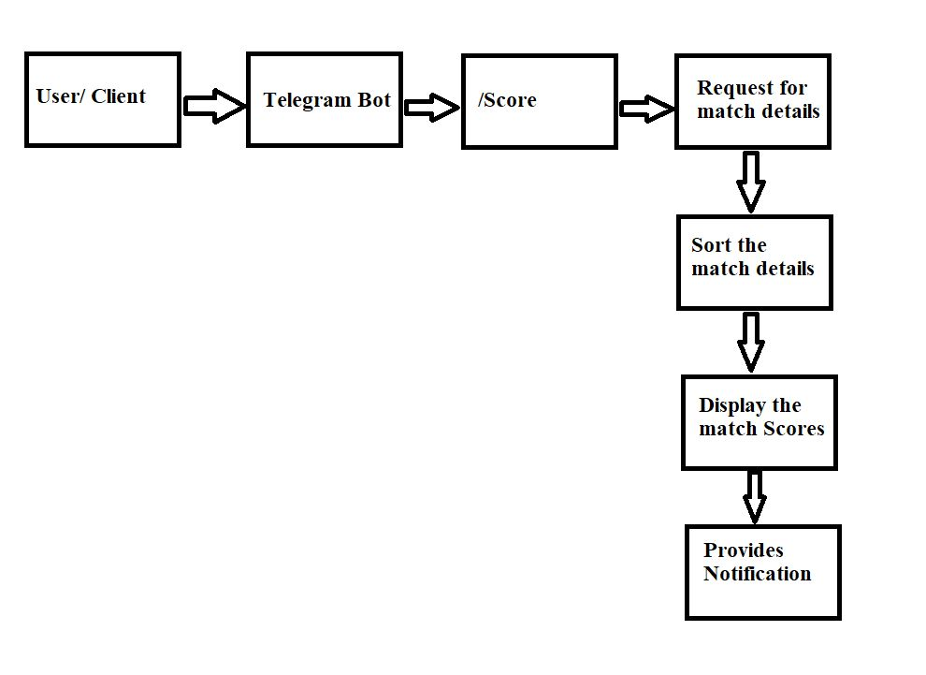
Proposed system architecture
The proposed solution uses a systematic approach to display scores through telegram with new functionalities and commands.

Slide 17
Comparison of Proposed system with an existed system
Existing system :
In Cricbuzz we should open the app and select the match for the
live.
As in the Cricket social media bot like discord bots and discord is an community
app that connects users with the same interests.
Proposed System :
As in the telegram bot it gives us the notification for the live matchs
Telegram bot is a personal messaging app for sending messages and sharing
media with your friends.
If we are in busy work and if client forget about match then we get the notifications
about the live match.
But if we can’t involve, after 5 mins the notifications will stop.

Slide 18
Proposed Methods
Our Proposed model will lead to the accomplishment of the following results:
We can know the score of the live match through the telegram bot.
Telegram bot will update every time and their will be no delaying of the score.
The score of the match will be notified in our mobiles when the match starts.
The live score updation will continue till the match ends.

Slide 19
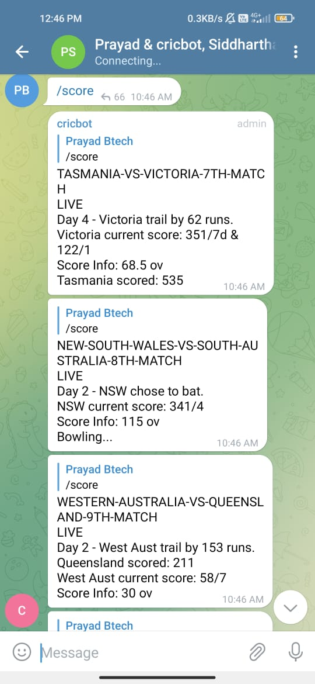
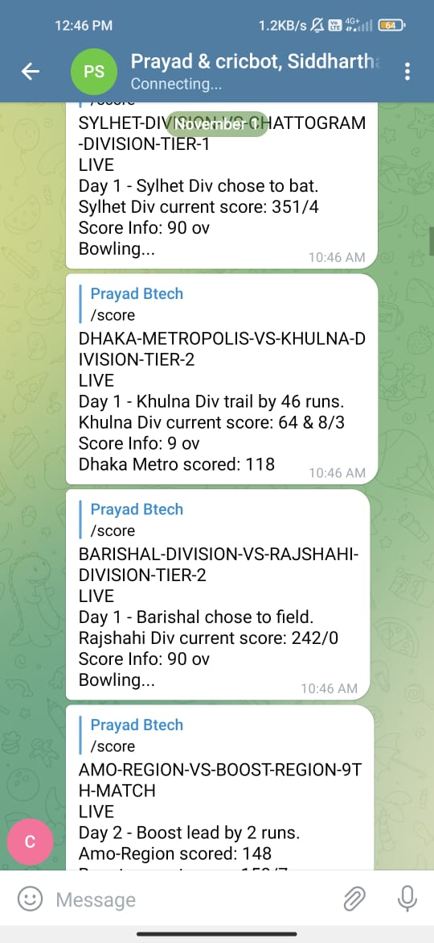
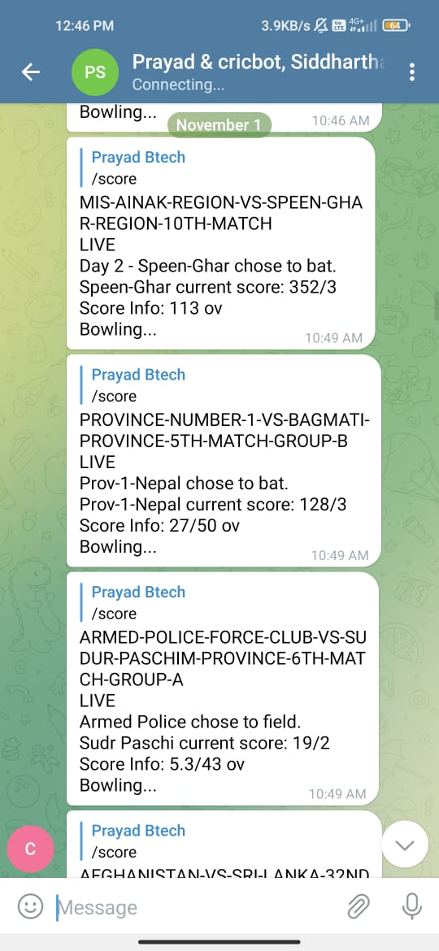
Performance Measure:
Here we can observe the live scores of the match and updating every time of every live
Cricket match.

Slide 20
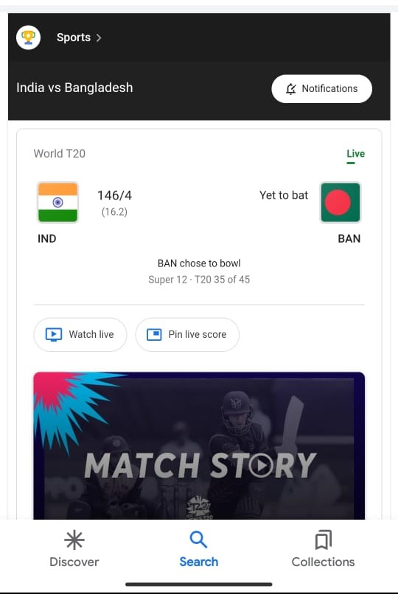
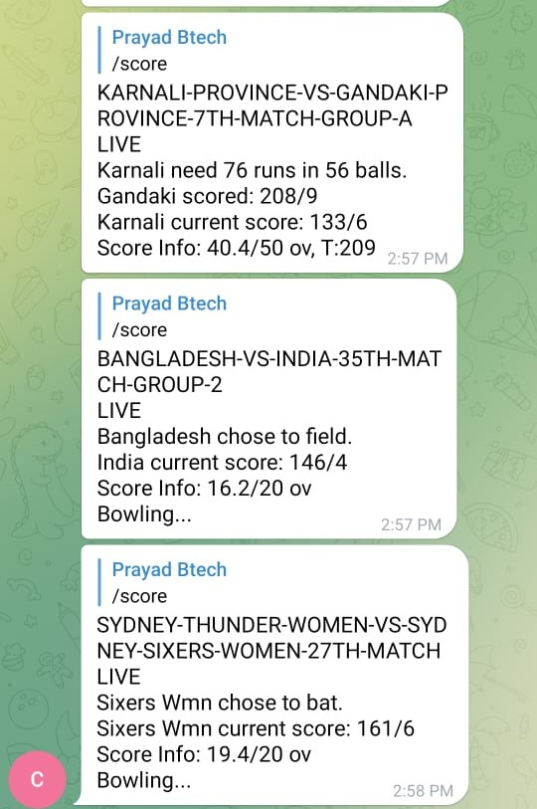
Result Analysis
Here we can see the accuracy of the live score of the match.It is 100% accuracy at the score.(the right side image is from google and the other image is from telegram bot)

Slide 21
Conclusion
The bot which we have developed is capable of sending the cricket updates in the telegram. The live cricket updates will be automatically. It extracts the live updates from the espn cric info web and organizes the json data and sends the data through the telegram chat. Such that people can chat and get updates of the cricket at the same time.This would be helpful for the people who cannot watch the match online and it consumes less amount of data rather than streaming online.

Slide 22
Future work
At present our bot sends the score which is scrapped through api and sends the data to the users.We can improve the accuracy by Fast API’s which receive the data and send to the user.
We can also update by adding all sports and their live match scores.So that user will be able to read all scores whatever they liked.

Slide 23
References
1) https://medium.com/@ajayececit/telegram-bot-for-cricket-scores-5e0cf2338f07
2) https://influencermarketinghub.com/top-telegram-bots/
3) https://influencermarketinghub.com/top-telegram-bots/
4) https://docs.aiogram.dev/en/latest/install.html#
5) https://docs.aiogram.dev/en/latest/quick_start.html

Slide 24
Thank You!

